Slide 1
Research at TULIP Lab
Gang Li
School of Information Technology
Deakin University, Australia

Slide 2

TULIP Team (http://www.tulip.org.au)
A/Prof. Gang Li
IEEE Technical Committee
IEEE Task Force on EDM (Vice chair)
Data Mining and Big Data Analytics (Vice Chair 2017)
Enterprise Architecture and Engineering
Enterprise Information Systems

Slide 3
TULIP Lab (Team for Universal Learning and Intelligent Processing)
Current Research Themes@ TULIP Lab
Behavior Informatics
Periodic Behavior Mining
Behavior Prediction
Information Abuse Prevention
Privacy Preserving Data Mining
Information Releasing Compliance Checking
Business Intelligence Applications
Recommender System
Tourism/Hospitality Management

Slide 4


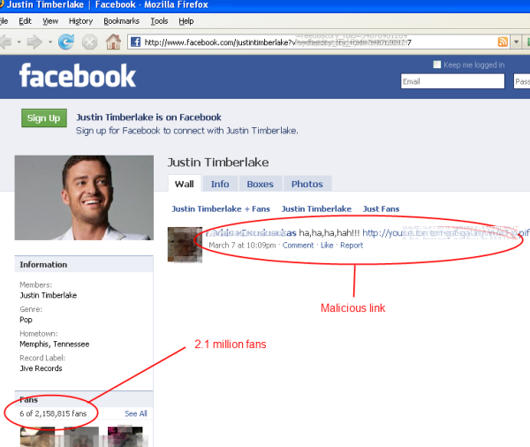


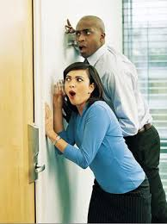

Theme 1. Behavior Informatics
People share news, interests and ideas in OSNs,
though these platforms also spread email malware, rumours, gossips and malicious links, and also leak our privacy.

Slide 5
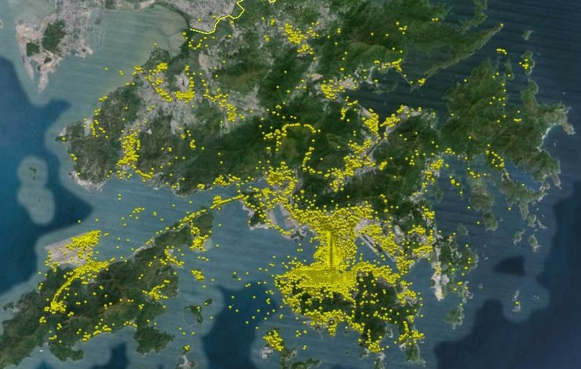

Application of Geo Photos
There are many geotagged photos available. However :
Data is noisy or misleading.
Photos are taken in transit rather than at the attractions.
Photo is static media, whereas, travel behavior is dynamic.
How to mine these data for travel behaviour analysis?

Slide 6
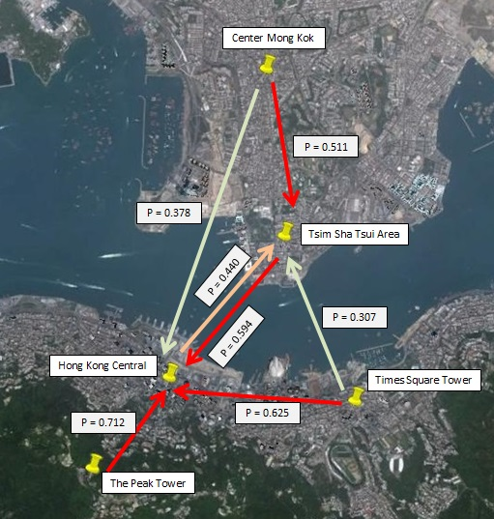
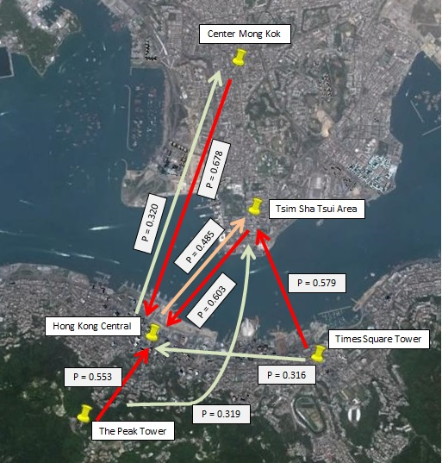
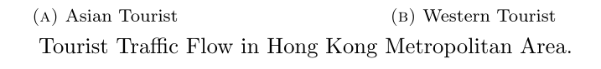
Tourist Movement Analysis
Notes:
Asian Tourists are likely to flow to Hong Kong central area from surrounding areas Tourist from Center Mong Kok tend to visit Tsim Sha Tsui as the next destination while, somes chose to travel directly to Hong Kong Central. Considerable tourist flow are found from Hong Kong Central and Times Square Towers to Tsim Sha Tsui
Western tourists tend to visit Hong Kong Central directly right after visiting Center Mong, while, somes travel in the opposite direction. Tourists are more likely to visit Tsim Sha Tsui than Hong Kong Central after visiting Times Square Towers. Some tourists visited Tsim Sha Tsui right after going to the Peak Tower.

Slide 7
Tourist Movement Analysis
Huy Quan Vu, Gang Li, Rob Law, Ben Haobin Yip. Exploring the travel behaviors of inbound tourists to Hong Kong using Geotagged photos. Tourism Management.

Slide 8
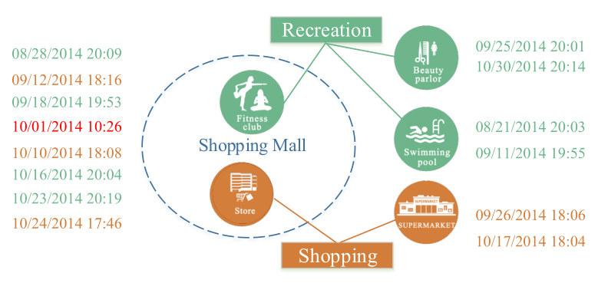
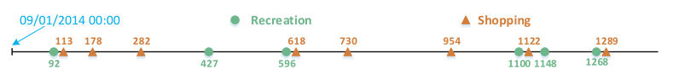
Periodic Behavior Mining
Observed Check-in Data is usually a mixed events from different periodic behaviors
What are Periodic?
What is the period?
Predict the Behavior on a particular day

Slide 9
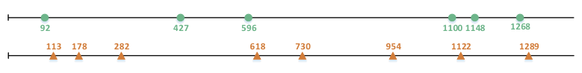
Periodic Behavior Mining
Observed Check-in Data is usually a mixed events from different periodic behaviors
What are Periodic?
What is the period?
Predict the Behavior on a particular day

Slide 10
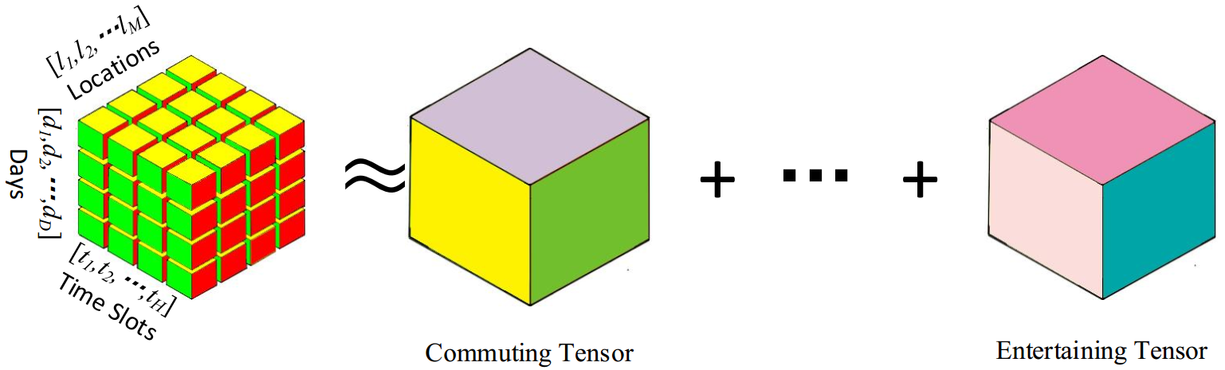
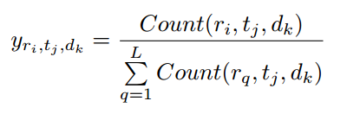


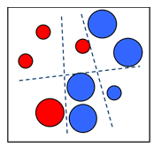











Periodic Behavior Mining Mobility Intentions
CP Decomposition
Users’ history records
Mobility Intention Sequence
… …
Mobility Intentions
…
… …
multi-class classifier

Slide 11
Periodic Behavior Mining Applications
There are various applications of Periodic Behavior Mining
What is the schedule of a person on a particular day/time?
Where to find the person on a particular day/time?
Police applications
Scheduled “Encountering” for match making
Timely Recommendation Systems
Now it is the time for you to stock rice, cooking oil, or ice cream!

Slide 12
P.R. Applications (Case 1: Face Age Recognition)
Xin Geng, Zhi-Hua Zhou, Yu Zhang, Gang Li, Honghua Dai. Learning from facial aging patterns for automatic age estimation. Proceedings of the 14th annual ACM international conference on Multimedia, 2006

Slide 13
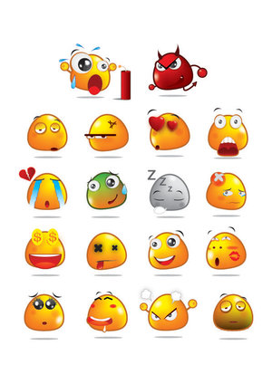

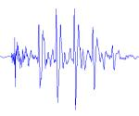
P.R. Applications (Case 2: Speech-based Emotion Detection)
Jia Rong, Gang Li, Yi-Ping Phoebe Chen: Acoustic Feature Selection for Automatic Emotion Recognition from Speech. Information Processing and Management, 45(3): 315-328 2009

Slide 14
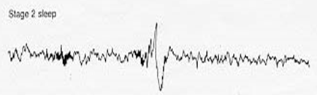
P.R. Applications (Case 3: K-Complex Detection)
Sleep Stage Identification
Rapid Eye Movement (REM) Sleep
A normal stage of sleep characterized by the rapid movement of the eyes (is relatively easily discernible in PSG)
20%-25% of total sleep time in human adults, memorable dream
Non-REM Sleep
N1: slow eye movement, hypnic jerks at beginning, believe fully awake
N2: non eye movement, rare dreaming, easily awaken
N3: deep sleep, sometimes dreaming, but disconnected, less vivid
General sleep order in cycles of REM and NREM: N1 → N2 → N3 → N2 → REM
Early in the night, a greater amount of deep sleep (N3)
Later in the night, REM sleep increases, and before natural awakening
Vu, Quan; Li, Gang; Sukhorukova, Nadezda; Beliakov, Gleb; Liu, Shaowu; et al. K-complex Detection using a Hybrid-Synergic Machine Learning method. IEEE Transactions on SMC(C), PP(99): 1-13.

Slide 15
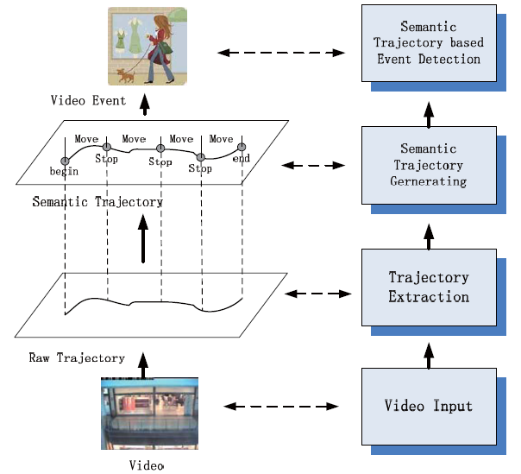
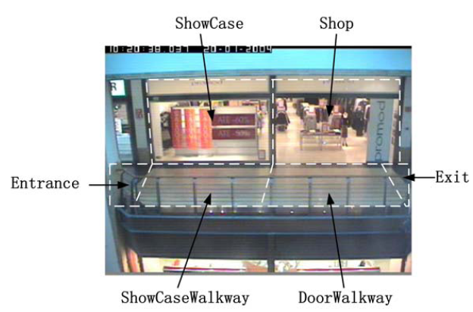
P.R. Applications (Case 4: Trajectory Analysis)
Xiaofeng Wang, Gang Li, Guang Jiang, Zhongzhi Shi. Semantic Trajectory based Event Detection and Event Pattern Mining, Knowledge and Information Systems (KAIS), pp. 1-25, 2011.

Slide 16
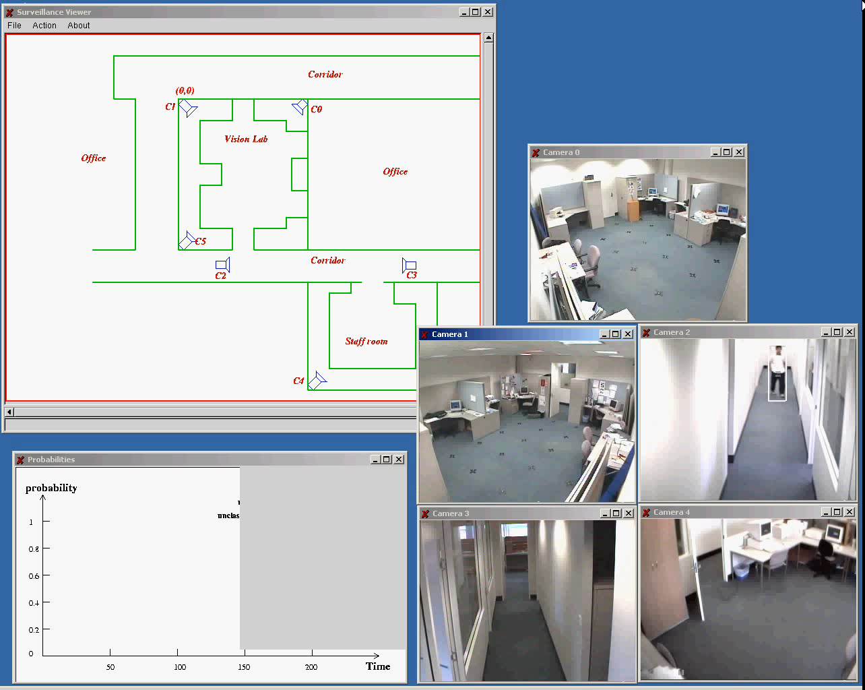
P.R. Applications (Case 5: Video Surveillance)

Slide 17
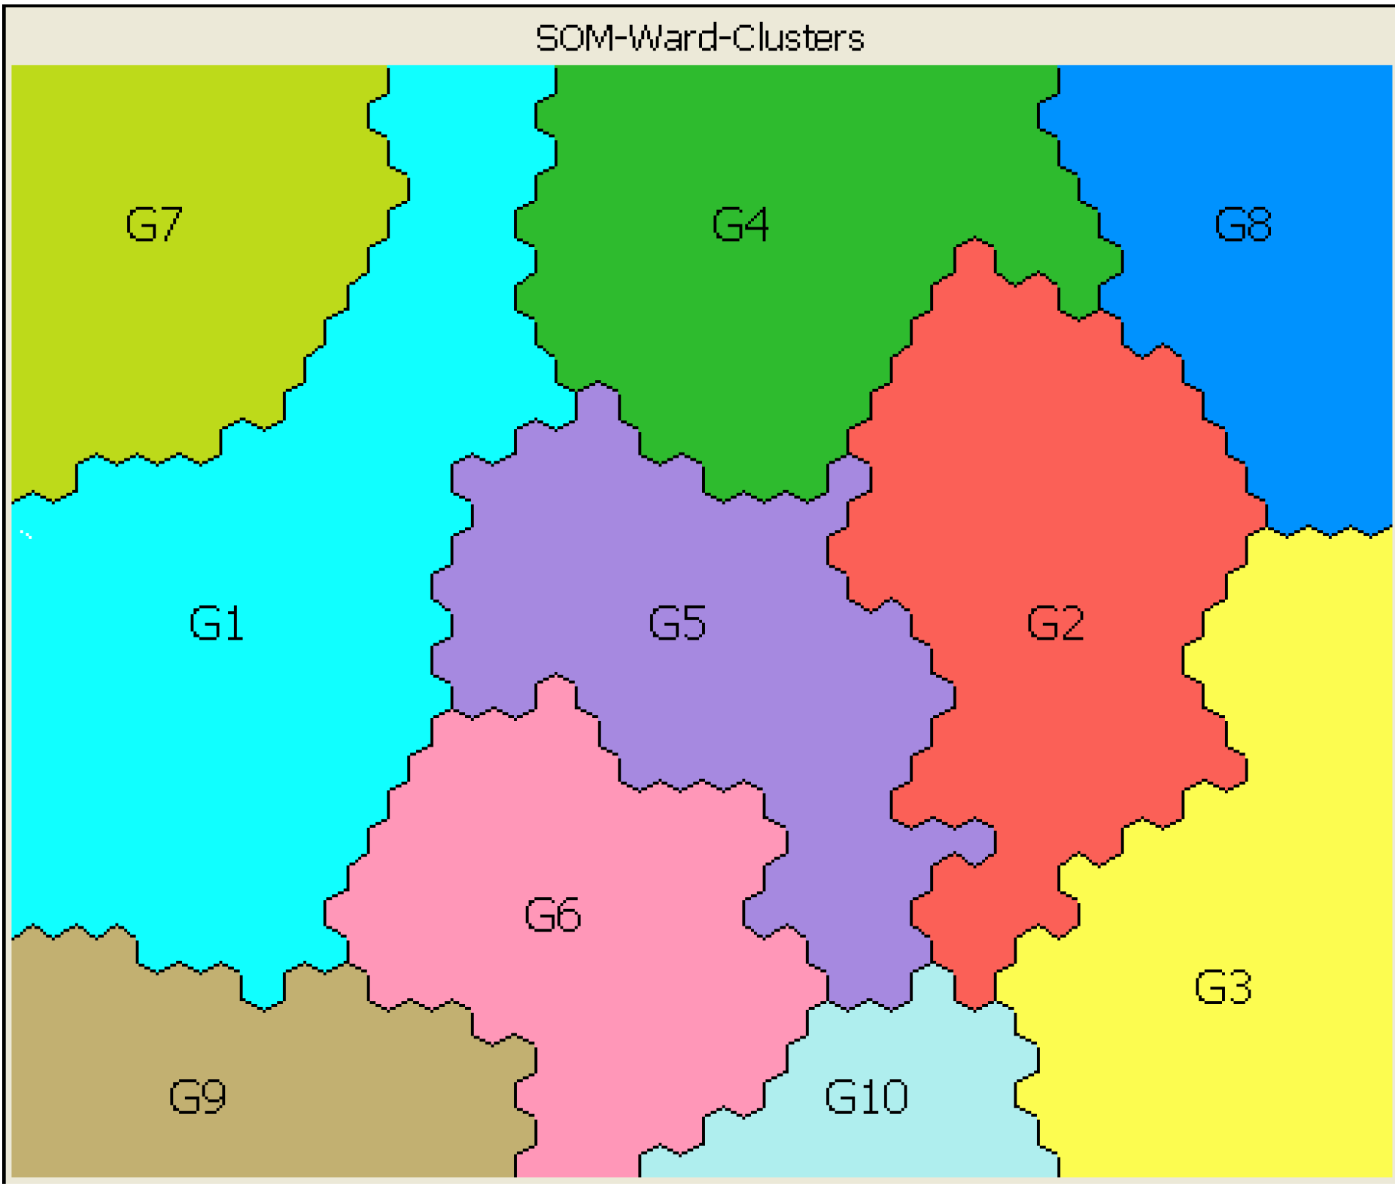
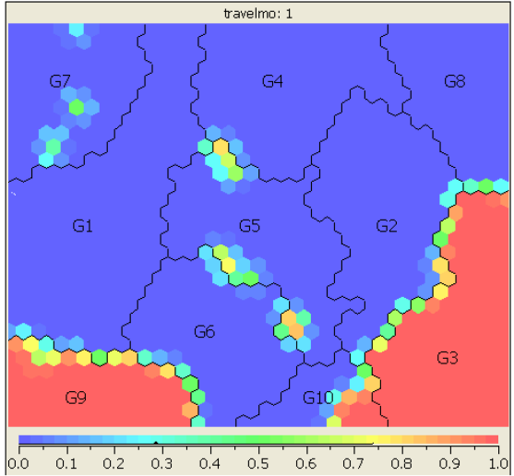
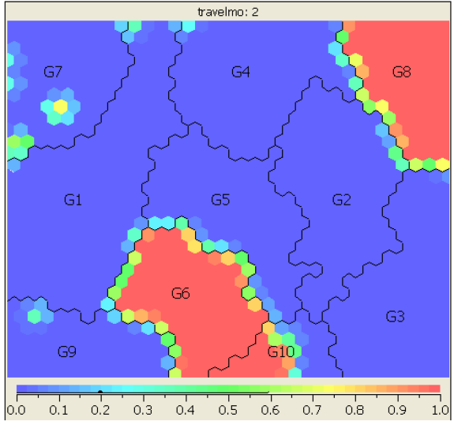
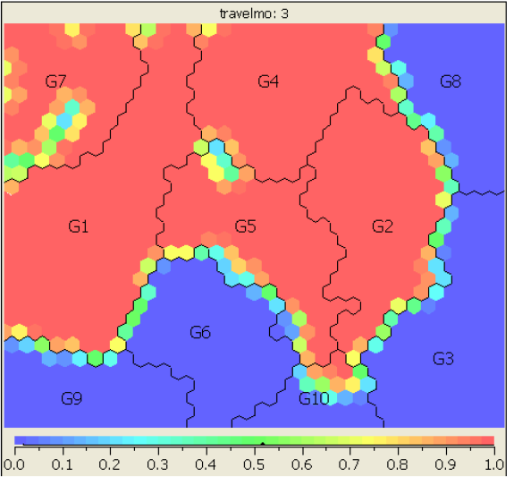
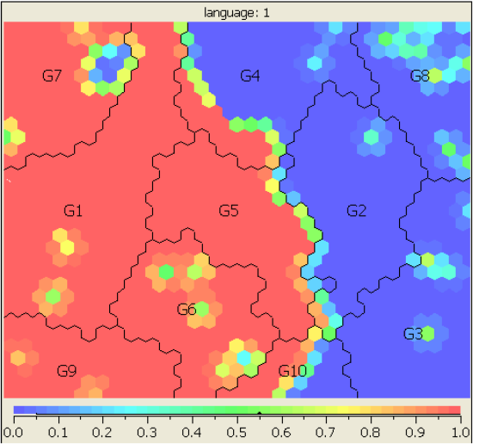
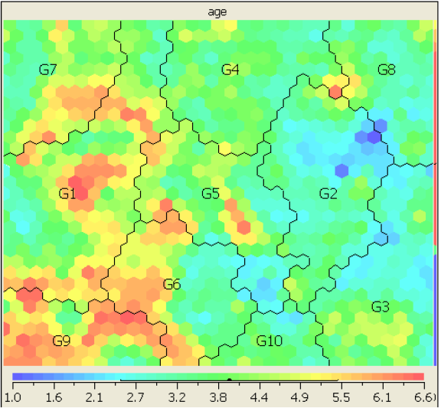
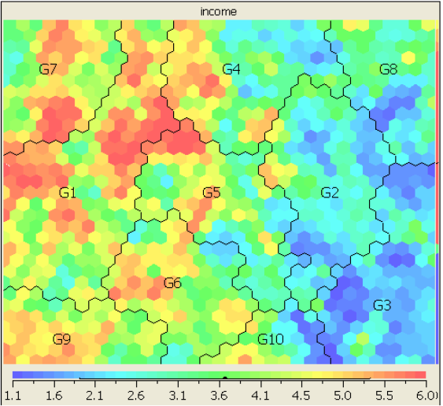
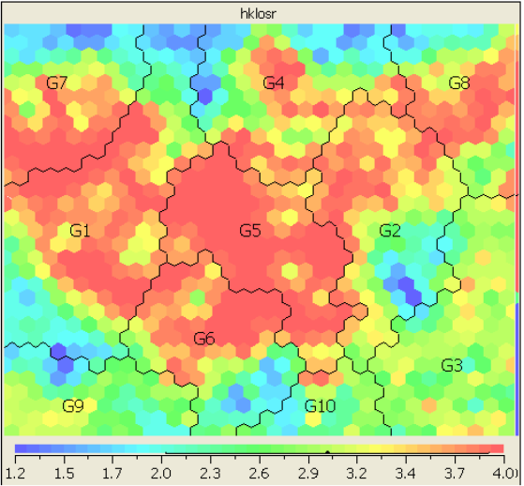
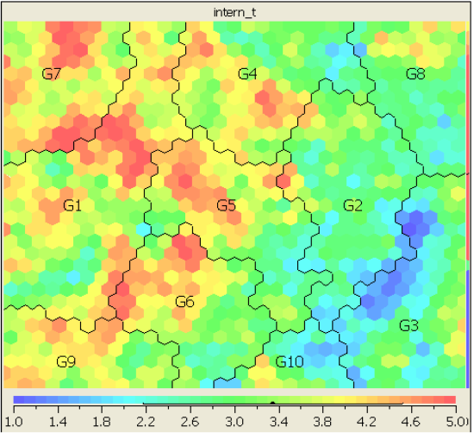
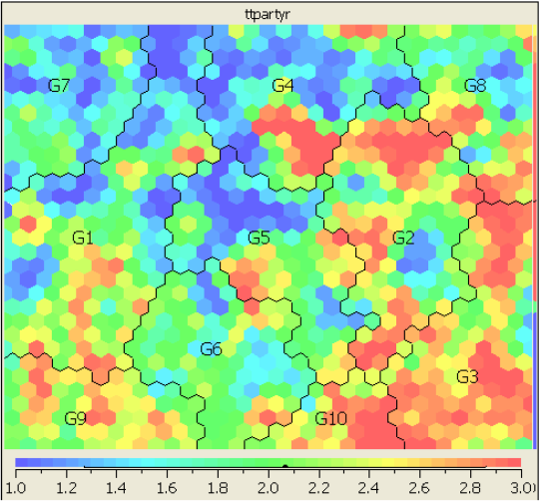
Market Segmentation Analysis
Travel Mode: 1
Travel Mode: 2
Travel Mode: 3
Language: 1
Age
partially packaged
Income
HK Length of Stay
Travel Experience
High income
Travel Party
Low income
partially packaged
old
Fully packaged
Fully packaged
Notes:
Asian Tourists are likely to flow to Hong Kong central area from surrounding areas Tourist from Center Mong Kok tend to visit Tsim Sha Tsui as the next destination while, somes chose to travel directly to Hong Kong Central. Considerable tourist flow are found from Hong Kong Central and Times Square Towers to Tsim Sha Tsui
Western tourists tend to visit Hong Kong Central directly right after visiting Center Mong, while, somes travel in the opposite direction. Tourists are more likely to visit Tsim Sha Tsui than Hong Kong Central after visiting Times Square Towers. Some tourists visited Tsim Sha Tsui right after going to the Peak Tower.

Slide 18
Theme 2. Information Abuse Prevention
Information Abuse:
The compromise of information for which the data stakeholders are not willing to disclose.
It depends on the nature of the information, the involved internal or external users, and the ways in which the organization grants the access to or releases the information.

Slide 19
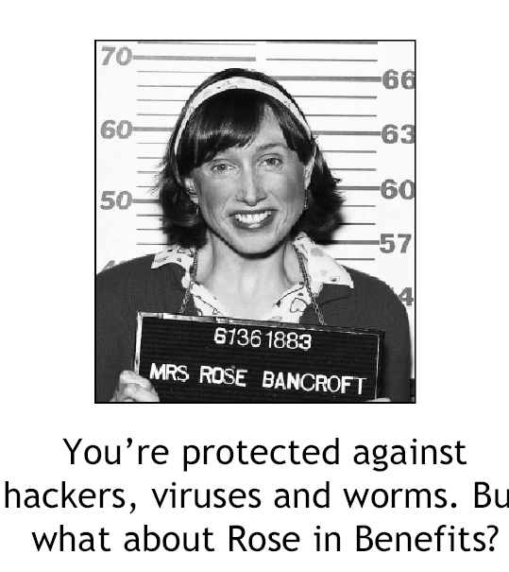

Who is an adversary?
Every user is potentially an adversary
After data is released, we cannot prevent any user from performing any type of analysis on the released data
Worst case scenario
Must account for disclosure risk from any and all types of analyses

Slide 20
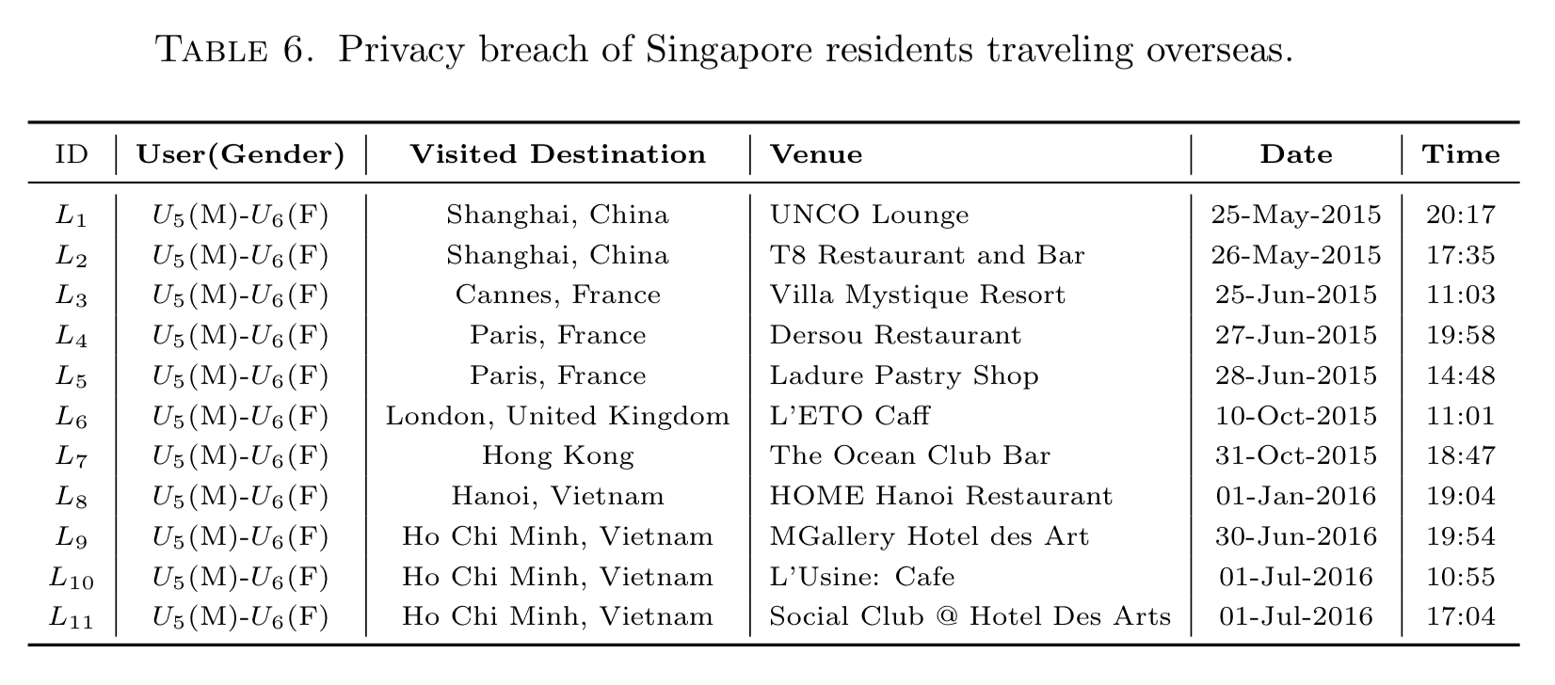
Privacy Breach Example (1)

Slide 21
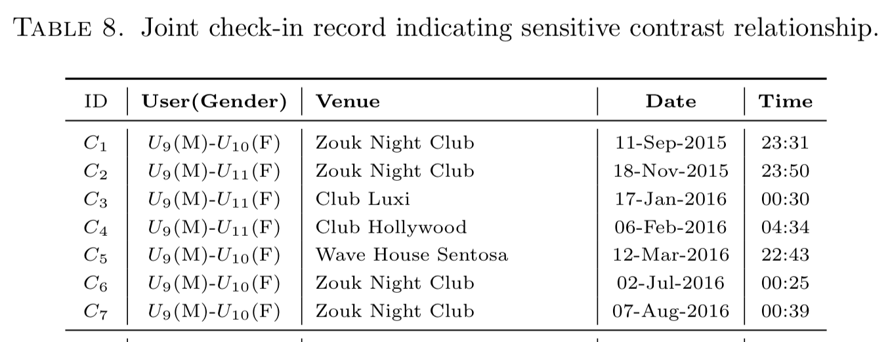
Privacy Breach Example (2)

Slide 22
Questions?

Slide 23
Privacy Preserving Related Reference
Privacy Preserving in Data Releasing
T. Zhu, G. Li, W. Zhou, P.S. Yu. Differential Privacy and Its Applications: Survey, IEEE Transactions on Data and Knowledge Engineering, 2017
T. Zhu, G. Li, W. Zhou, P.S. Yu. Differential Privacy and Its Applications, Springer 2017
T. Zhu, P. Xiong, G. Li, W. Zhou. Correlated Differential Privacy: Hiding Information in Non-IID Dataset. IEEE Transactions on Information Forensics & Security, 2015, 10(2), 229-242

Slide 24

Contact
A/Prof. Gang Li
School of IT, Deakin University VIC 3125, Australia
gang.li@deakin.edu.au
Phone: +61(3)925-17434
Office: T207.WS14 (Burwood)
Director of TULIP Team
http://www.tulip.org.au
TULIP Publications
http://www.tulip.org.au/publication

